Slide 1
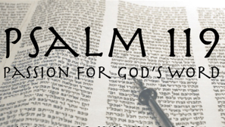
The Alphabet of God’s Word
- A Panoramic Look at Psalm 119 -

Slide 2
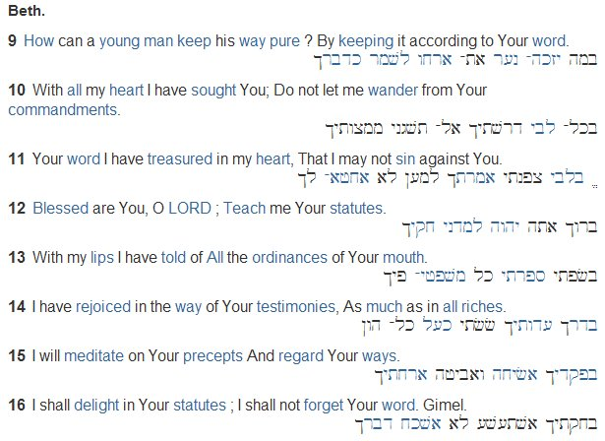
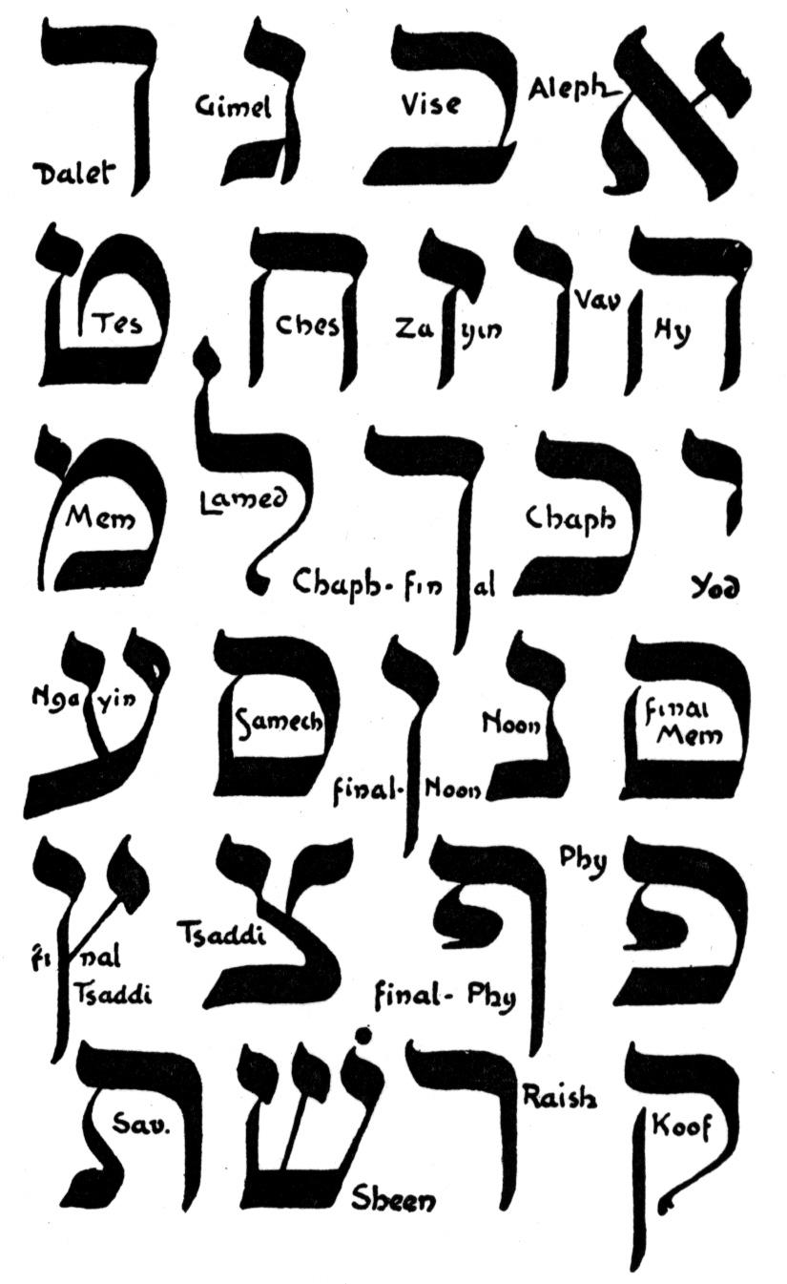
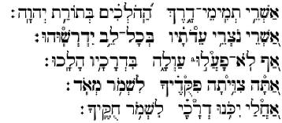
Alphabetic Acrostic Poetry

Slide 3
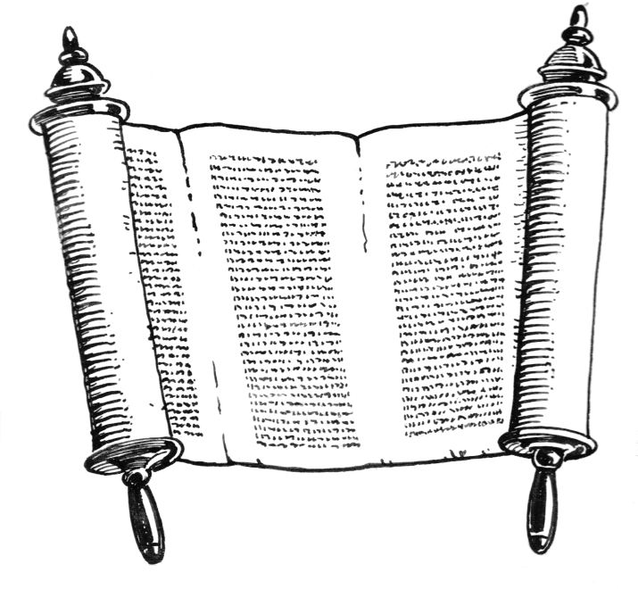
God’s Law
Hebrew word “Torah”
25 times in this Psalm
“Blessed are the
undefiled in the way,
Who walk in the law
of the LORD!” (1)

Slide 4
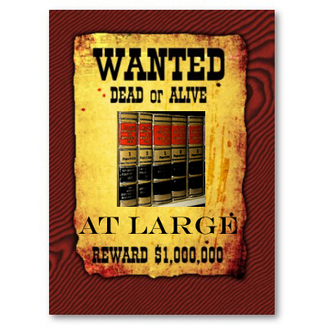
God’s Statutes
Written enactments of God within the scope of His law.
22 times in this chapter
Let my heart be sound in Your statutes; that I be not ashamed. (80)

Slide 5
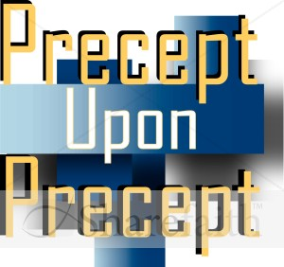
God’s Precepts
Precepts are His established definitions that reflect the truth
21 times in this chapter
“I will meditate on Your precepts,
And contemplate Your ways.” (15)

Slide 6
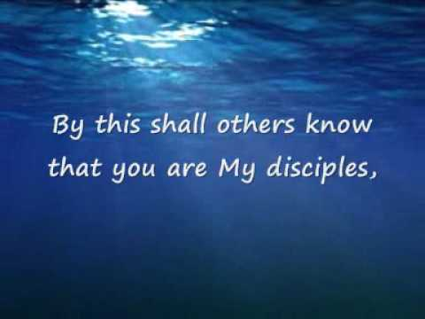
God’s Commandments
Govern the moral universe
23 times in this chapter
And I will delight myself in Your commandments,
Which I love. (47)

Slide 7

God’s Way
“Way” implies direction
20 times in this chapter
“They also do no iniquity;
They walk in His ways.” (3)

Slide 8

God’s Judgments
God will right every wrong by the perfect sinless standard of His Son
19 times in this chapter
“I remembered Your judgments of old, O LORD,
And have comforted myself.” (52)

Slide 9
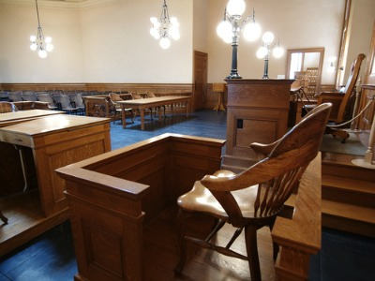
God’s Testimonies
Witness for the truth
23 times in this chapter
I will speak of thy testimonies also before kings, and will not be ashamed. (46)

Slide 10

God’s Word
The written pages of the Bible are the revelation of God Himself to men
42 times in this chapter
“Forever, O LORD,
Your word is settled in heaven. Your faithfulness endures to all generations;
You established the earth, and it abides.” (89-90)
“The entirety of Your word is truth,
And every one of Your righteous judgments endures forever.” (160)

Slide 11

God’s Heart
Our heart needs surgery
We love Him because He first loved us
15 times in this chapter (14x = “whole heart”)
“Your word have I have hidden in my heart,
That I might not sin against You.” (11)

Slide 12
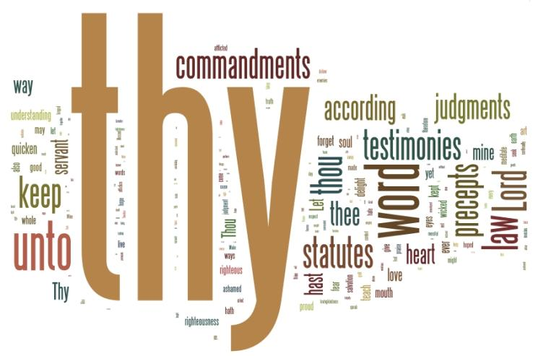
Laying Hold of God Himself!
“Thou art my hiding place and my shield: I hope in Thy Word.” (114)

